Slide 1
TOUR GUIDE

Slide 2
PRESENTERS:
Guide:
MADHUKAR RAO SASIDHAR
2010030362_M.RUSHITHA SRI
2010030436_K.DIMPLE
2010030438_K.SIRISHA

Slide 3
Abstract
Problem statement
LANGUAGES & TOOLS
GITHUB
Implementation
Output screenshots
CONCLUSION
THANKYOU
TABLE
OF
CONTEnT

Slide 4


ABSTRACT
The main aim of this project is to provide services to the users. The services regarding to city, conventional places, routes. Tour Guide is a web-based product used to store the details of particular city and helps all the users who just visits our website. This site also provides all the services like Hotel booking for tourists, booking, Transport facility providing food. The website contains the complete information about particular city like places to be visited, packages, environment, information about organization that provide transport. This website can be used by any person who is having general knowledge about internet.

Slide 5

PROBLEM STATEMENT:
For people who want the trip planned entirely, who don’t want to use the filtering method of pen and paper or trace filtering tour guide helps them completely. The tour guide is a website that helps vacation goes plan out where to go and what to see based on their interests.

Slide 6
LANGUAGES:
TOOLS:
JAVA
SERVLET
JSP
CSS
MYSQL
ECLIPSE IDE
TOMCAT SERVER

Slide 7
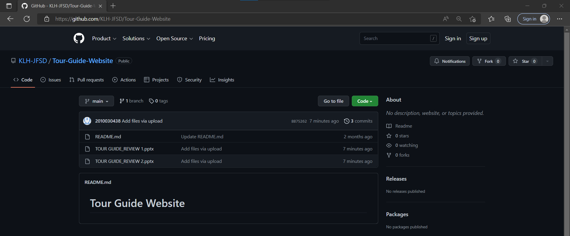
GITHUB:
https://GitHub - KLH-JFSD/Tour-Guide-Website

Slide 8
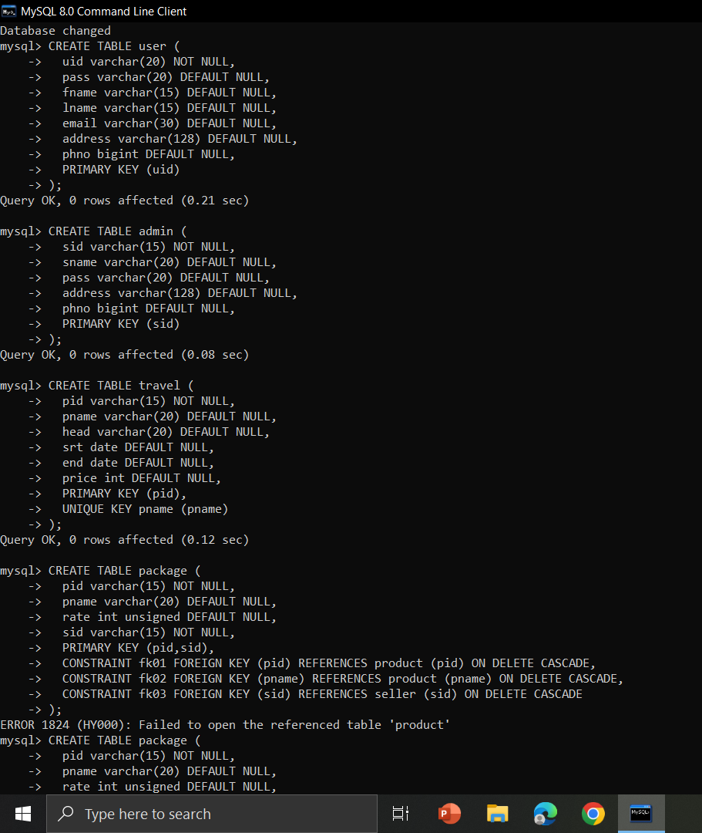
IMPLEMENTATION:
Database For Our Project:

Slide 9
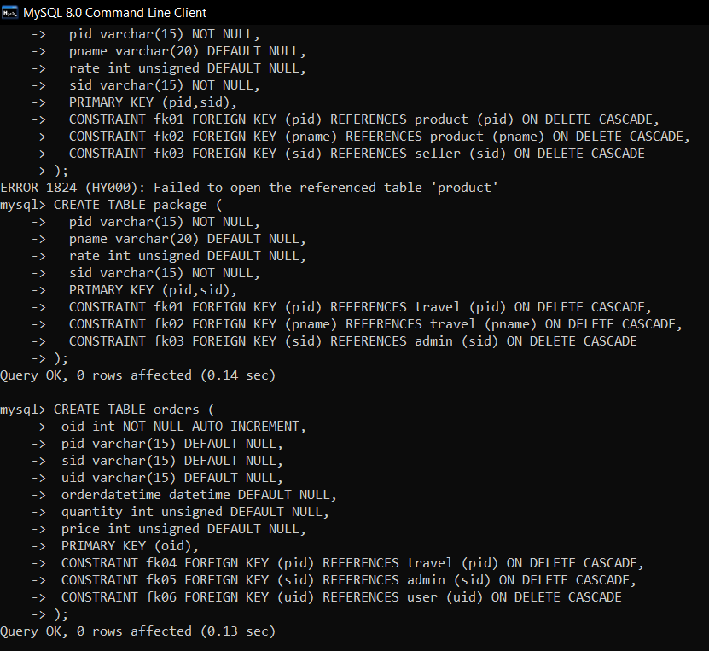
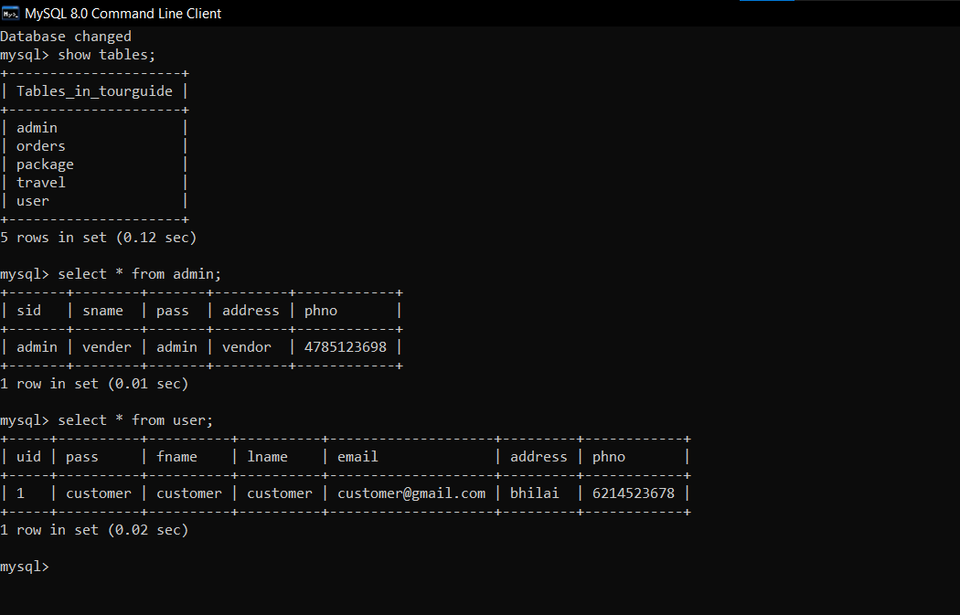
Created database for our Project and added values into the tables.

Slide 10
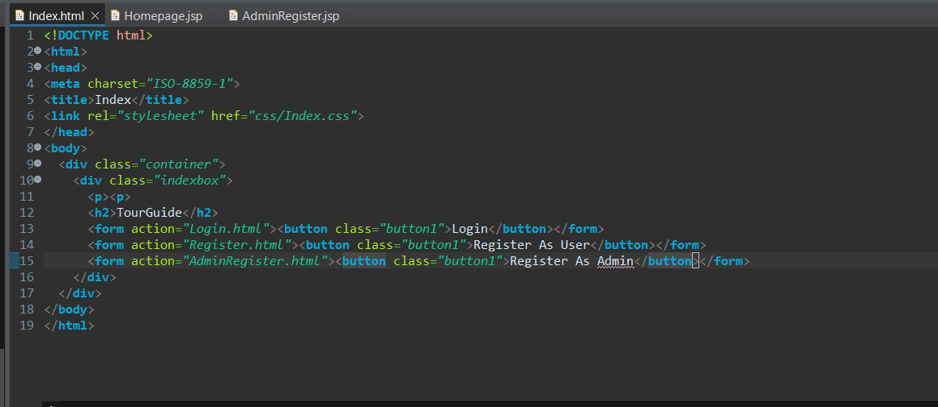
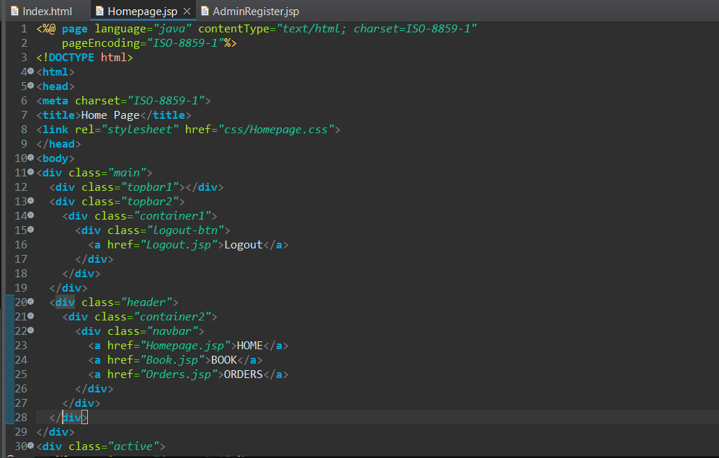
CODE:

Slide 11
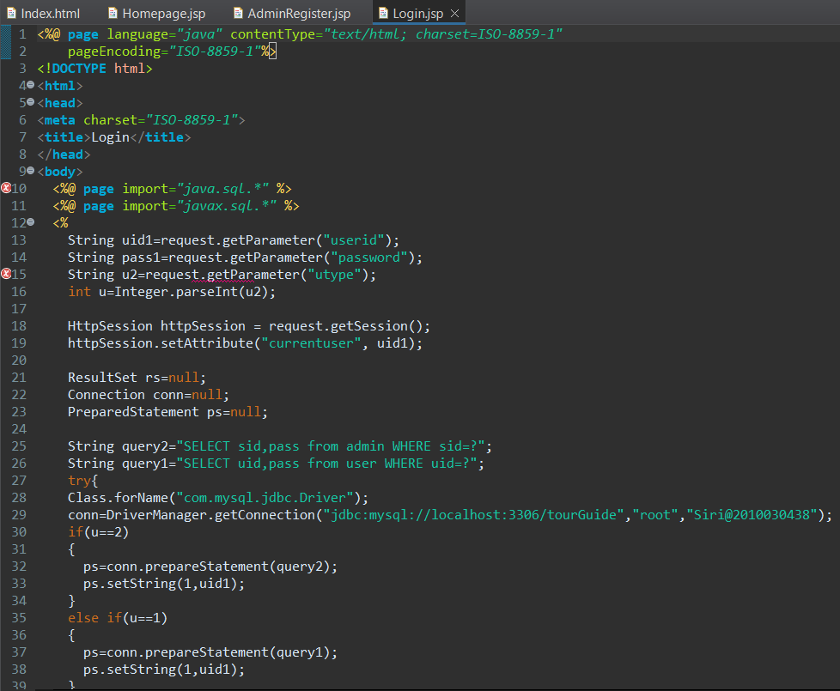
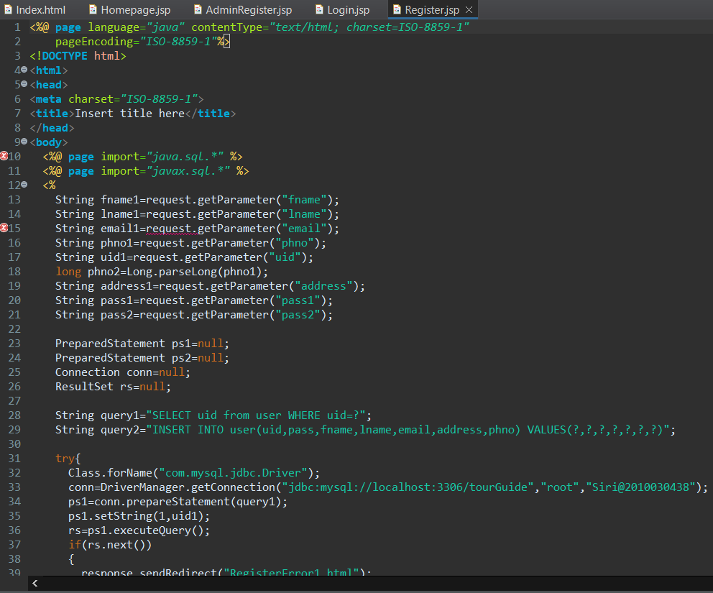
JSP CODES:
Login.jsp Register.jsp

Slide 12
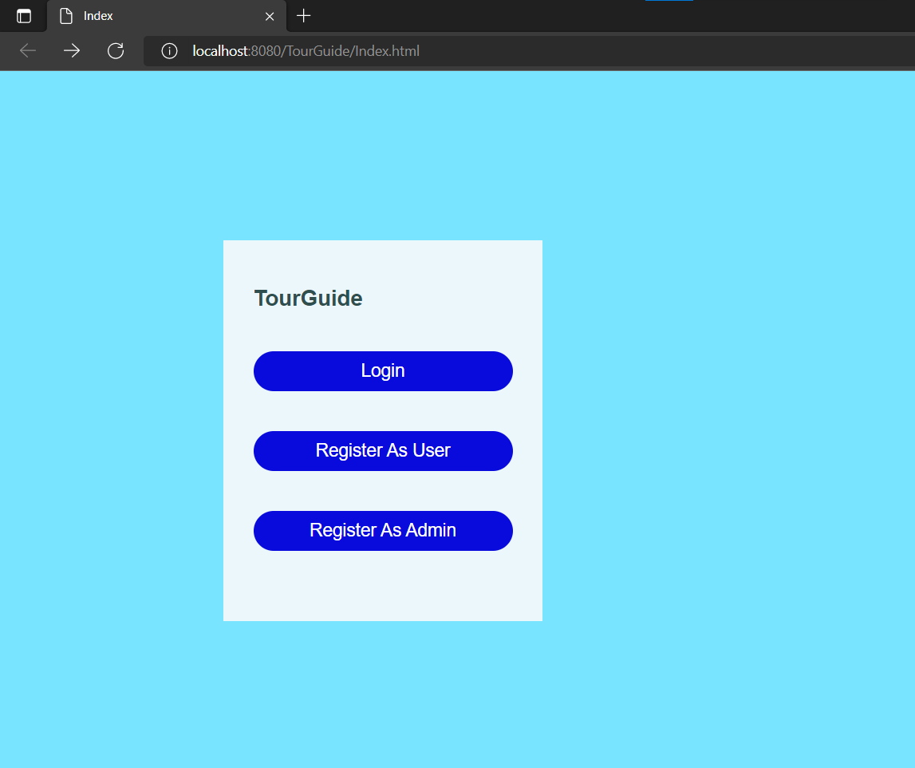
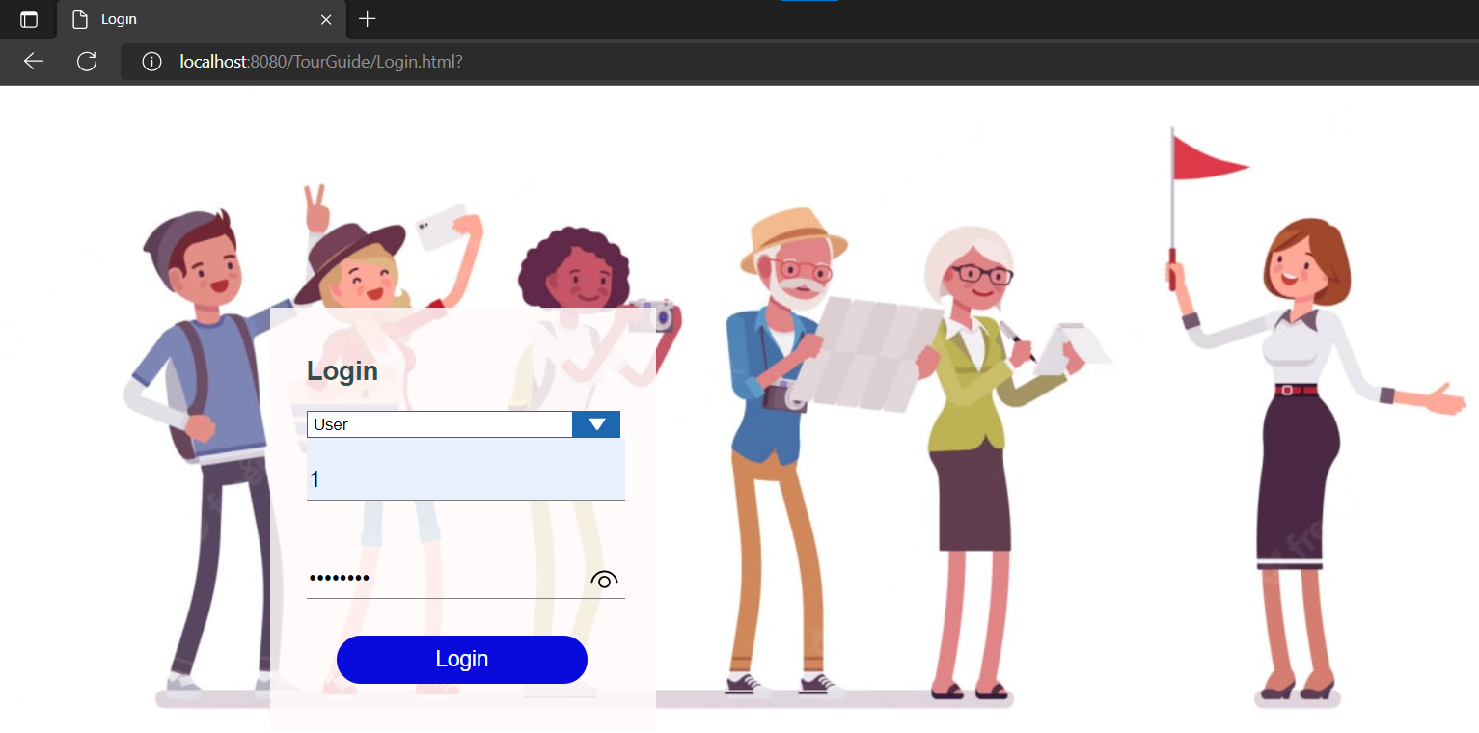
OUTPUT:

Slide 13
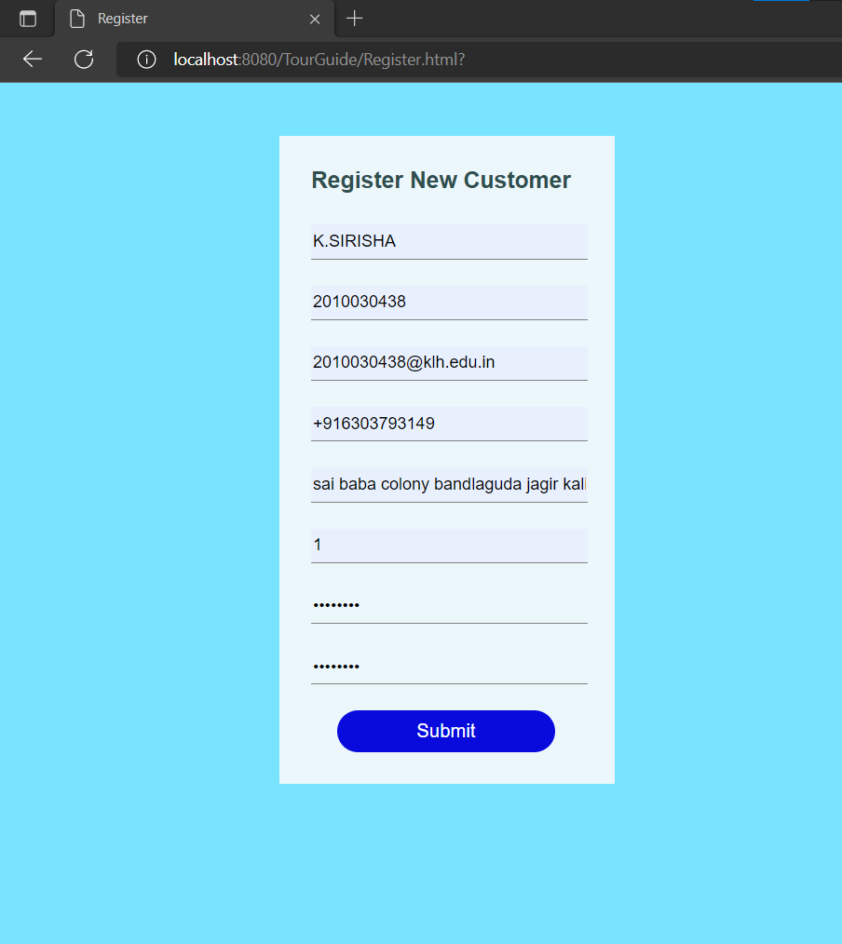
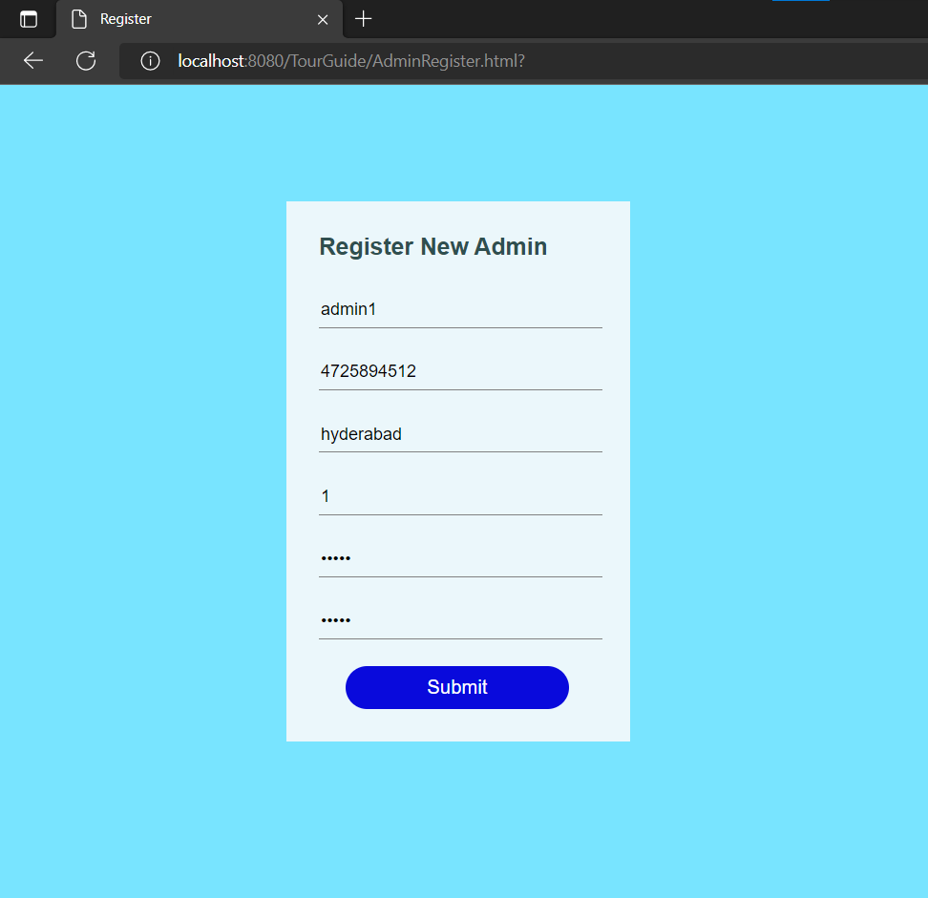

Slide 14
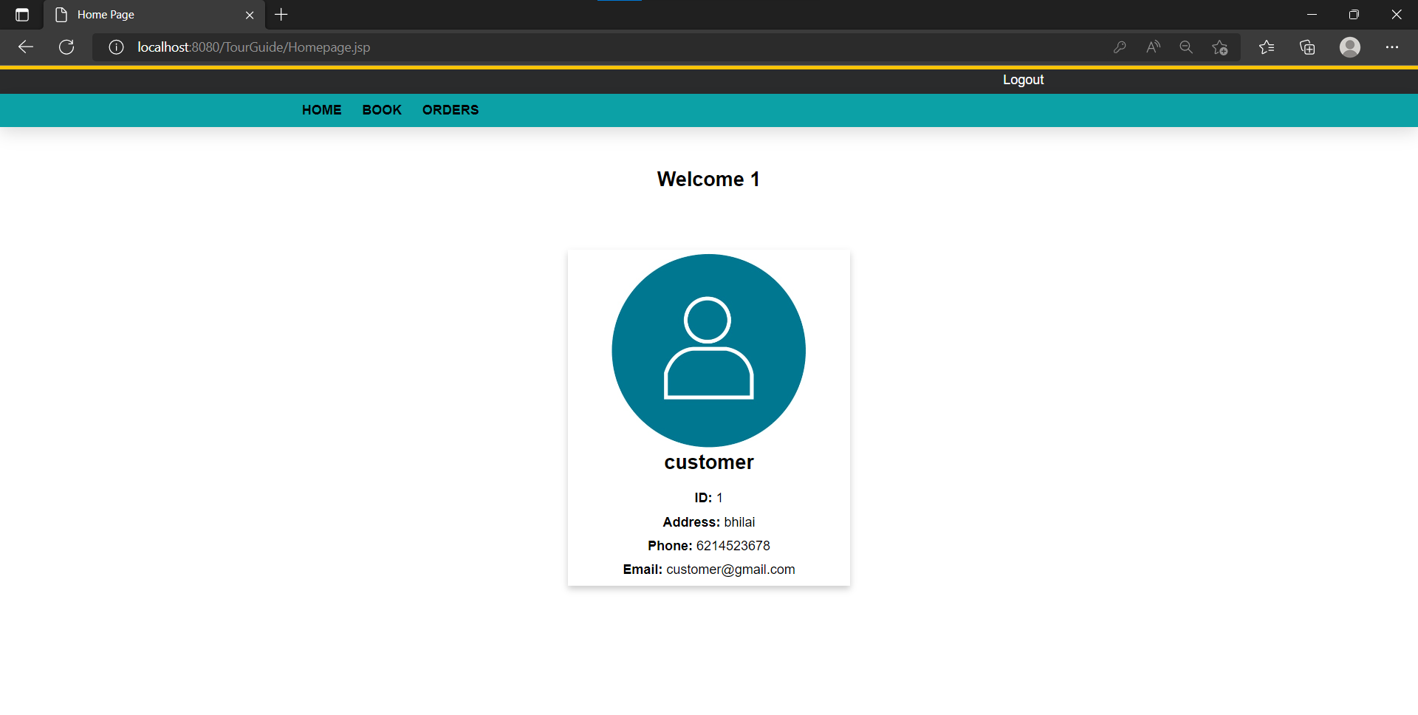

Slide 15
CONCLUSION:
The Website is to facilitate the offline customer online because customers cannot spend their precious time in markets trying to find out the best.

Slide 16


THANK
YOU

